Slide 1
Team Name: Team V
Name of Solution/Product:
KitchSafe 1101
Team ID: DC69
Notes:
Feel free to edit the ppt. Approach mentors for any doubts , Naming format for the ppt “Team ID_Contrive21”

Slide 2
PROBLEM STATEMENT
Problem statement 3:
We often see that the family member who cooks food forgets to switch off the burner due to their engagement in different activities simultaneously. At times, this results in overcooked/burnt food or even spillage of food. These problems are more common, especially when the person who cooks food has memory loss. Even though induction stoves may solve the issue, gas burners are widely used in our homes compared to induction stoves. Hence come up with a feasible yet safe device that can be used to overcome this issue.

Slide 3
BACKGROUND RESEARCH!
Overcooking and spillage of the food material are the most common accidents occurring while cooking in the gas stove. The cleaning up results in lots of extra work and overcooking results in wastage of the food. Some incidents are even recorded having severe burns. Hence, we need an arrangement responds and reacts immediately when the foods start overcooking or the constituents are about to spill.
There are a couple of such devices developed by private or individual entities but are found to be quite heavy, bulky and importantly, costly(hundreds of US dollars) which is why they have not found their way into the households. This requires us to think, design and fabricate a relatively small, light, convenient, reliable and reasonably priced product which can hopefully find the daylight and help improve our standard of living in the aspect discussed above.

Slide 4
PROPOSED SOLUTION
Introducing KitchSafe 1101, a product which is both economic and durable. It makes use of simple electrical components and has very minimal moving parts. This product prevents both overcooking and spillage of food material.

Slide 5
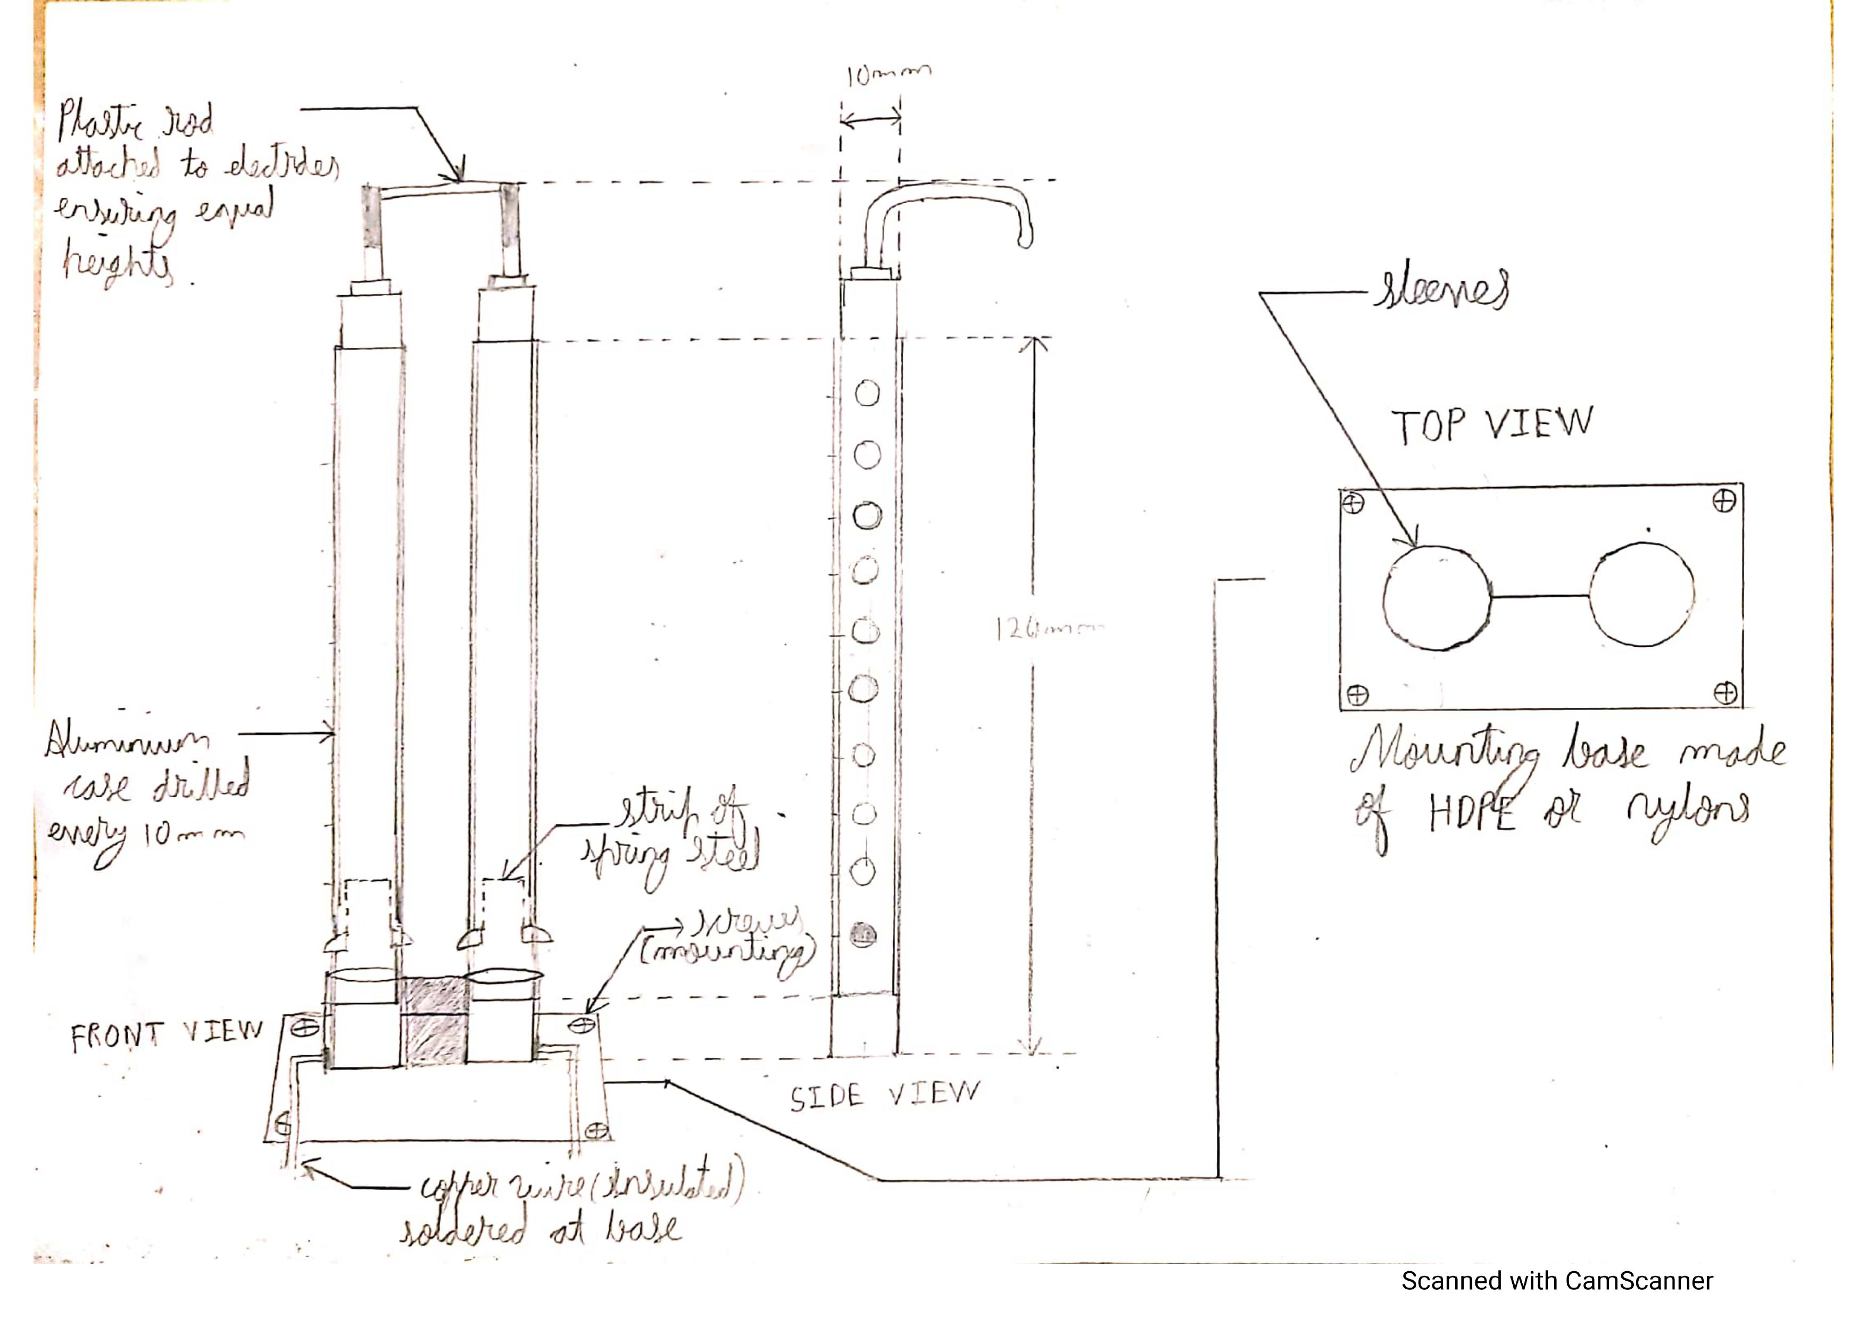
The device here utilizes two parallel circuits which prevents overcooking by checking the temperature and spillage of food by a electronic arrangement.
Spill-Proof Mechanism:
Electrodes are placed just over the vessel whose height can be adjusted with the help of a button-lock mechanism. The electrode heads are made of stainless steel which does not harm the quality of food and can be cleaned easily.
Salts and minerals present in the food conduct electricity and complete the circuit. Since the resistance is high, very low current(order of mA) flows in the circuit and thus does not harm the quality of food
One end is connected at the base of the transistor(NPN). Two batteries are kept in series and are connected to the collector point. Hence, amplification of current occurs which is sent to the solenoidal arrangement, via the emitter point, approximately represented as a resistor of 3 ohms.
Notes:
Working, sketch, design, parts etc

Slide 6
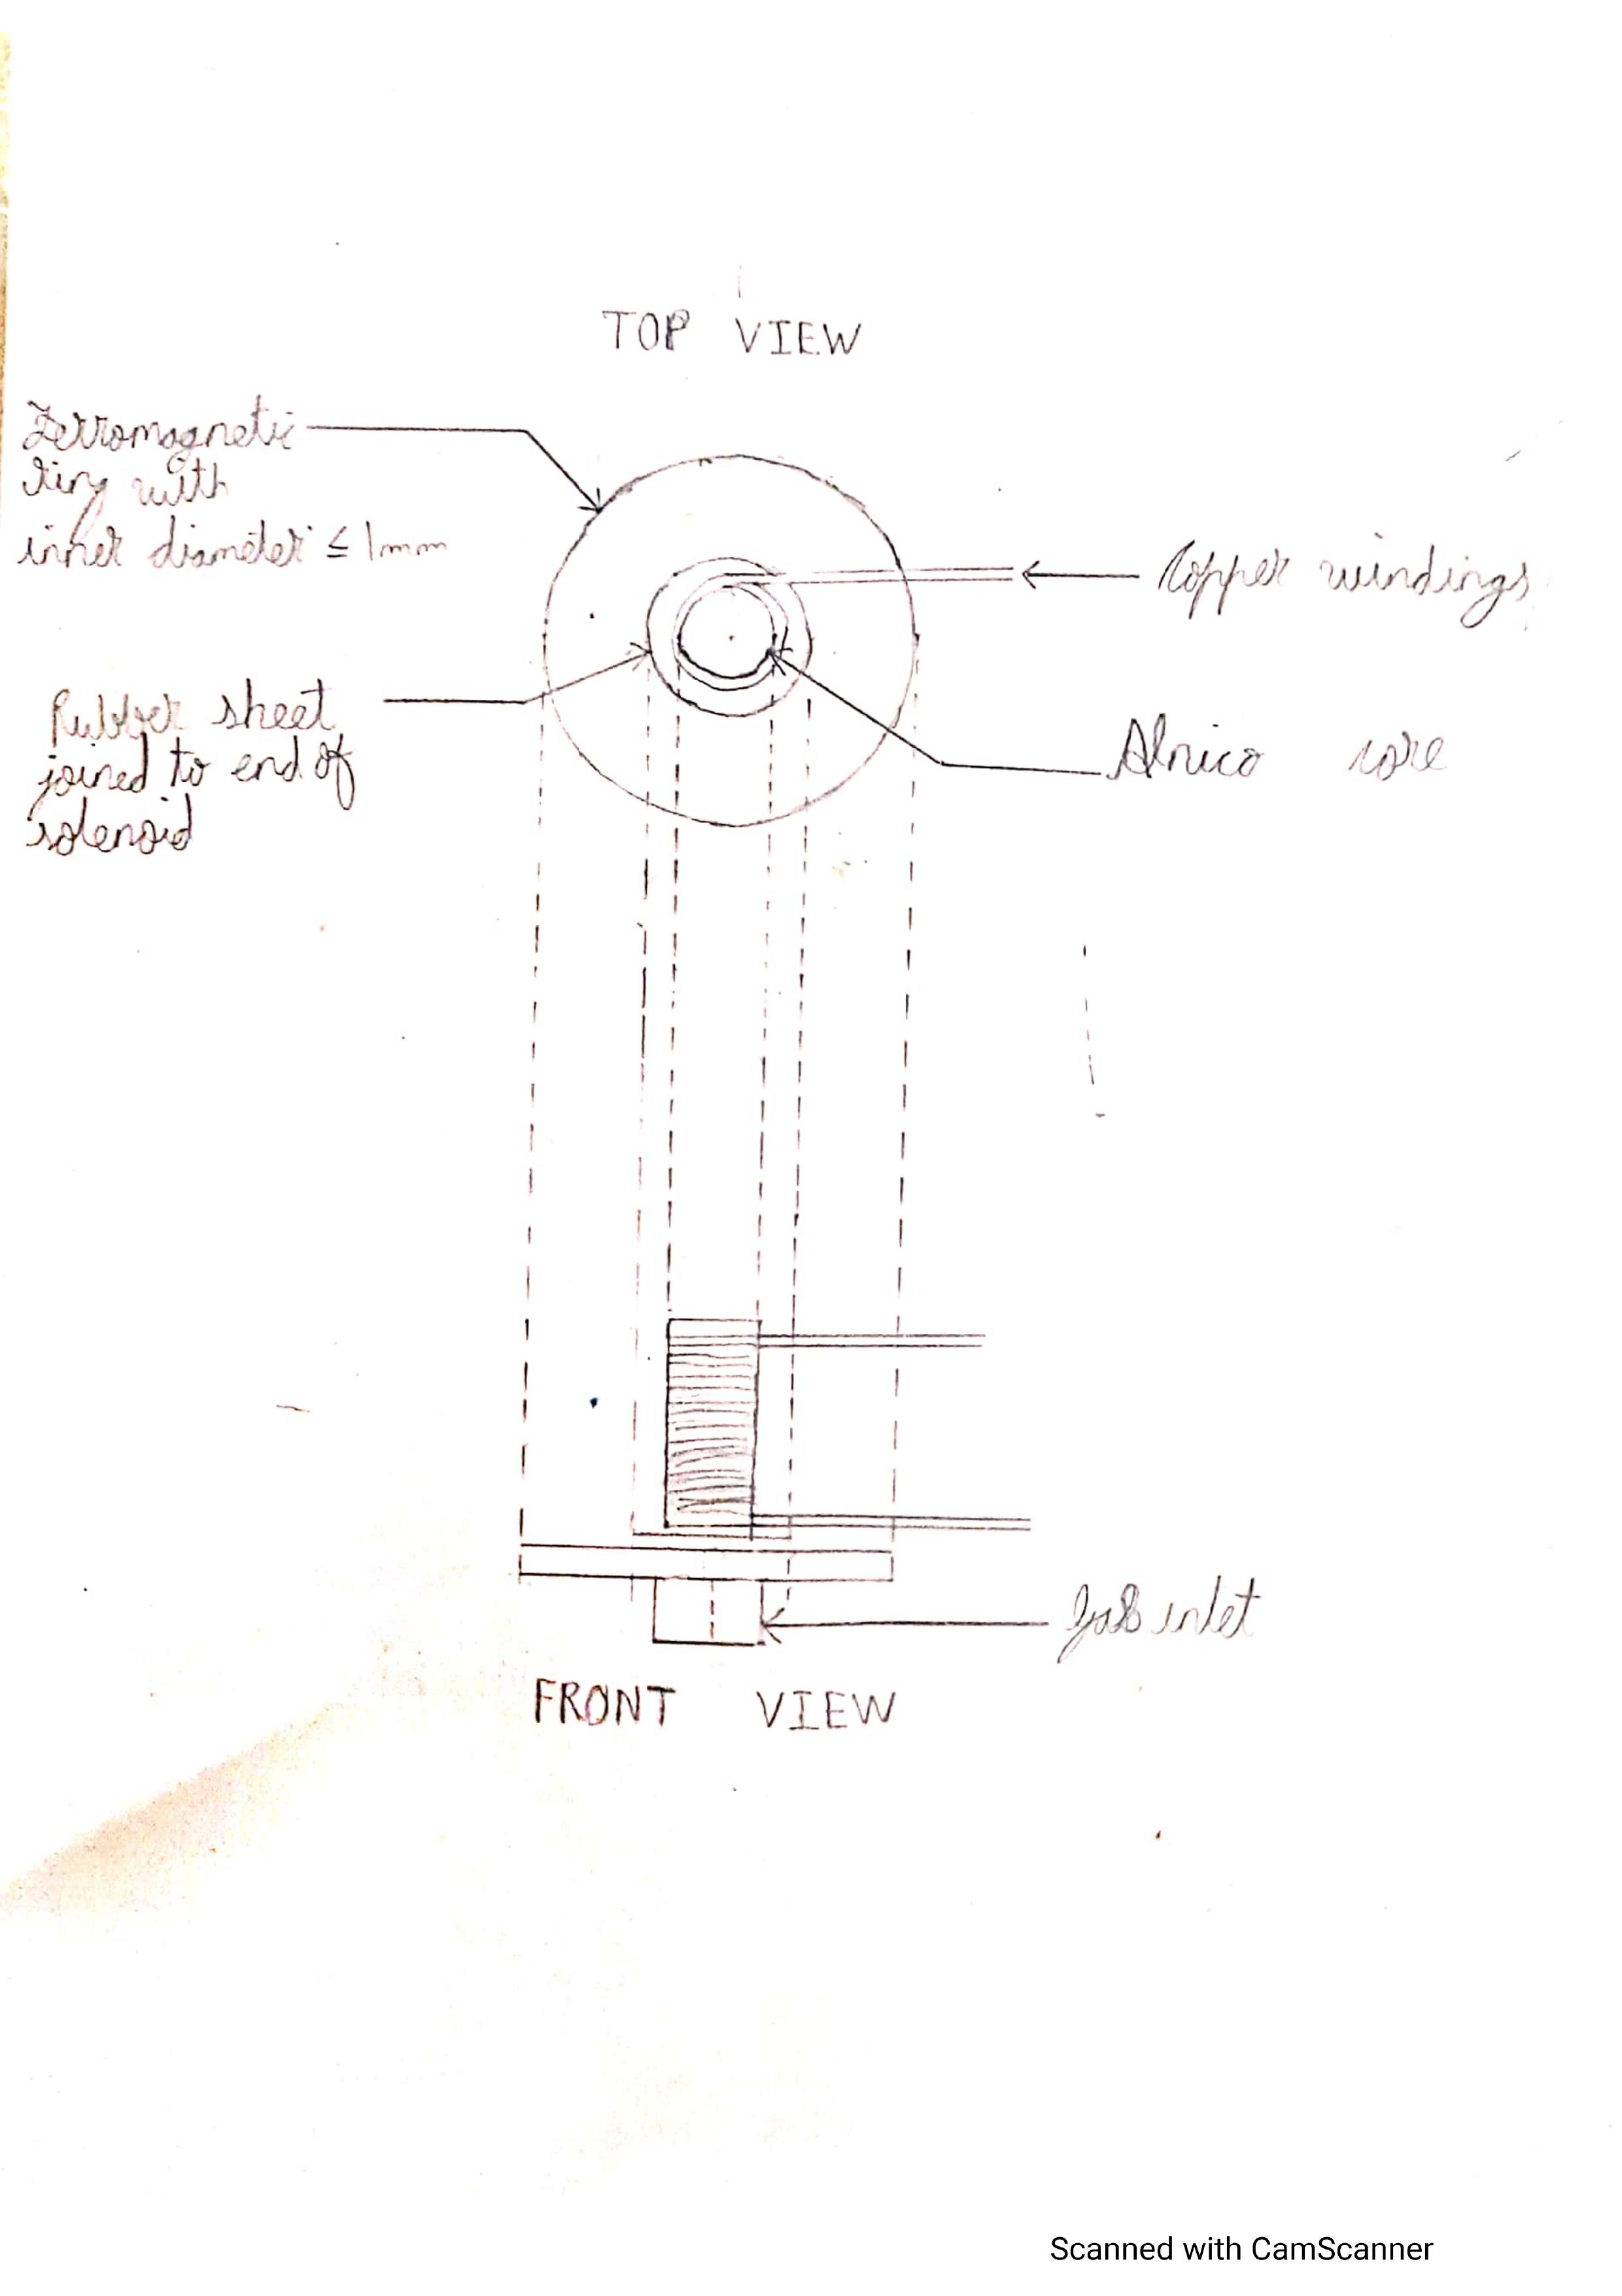
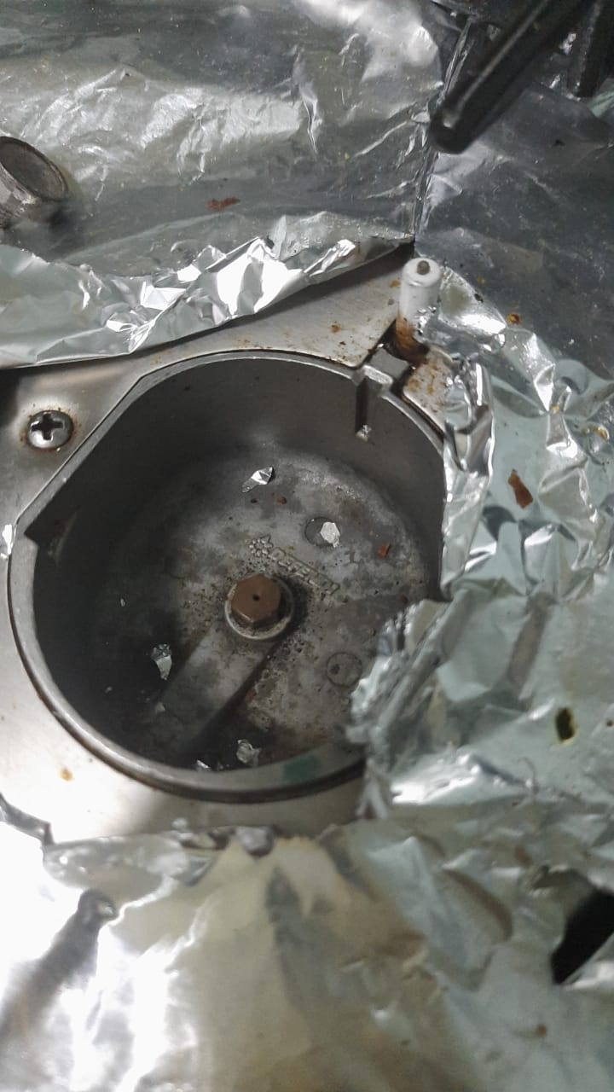
When the current passes through the Alnico cored solenoid, it behaves as a bar magnet which gets attracted to the iron ring. Now a circular rubber disc is glued to the solenoid which seals the gas outlet, thus stop the cooking(refer the adjacent diagram).
The circuit is completed by joining the wires with the corresponding terminals.
The gas outlet.
Note: The gas outlet and region surrounding does not get much hotter than room temperature as the gas burns only upon coming in contact with the air after passing through the burner as verified experimentally. Hence the solenoid mechanism remains intact and functional over long periods.''
Notes:
Working, sketch, design, parts etc

Slide 7
Prevention of overcooking:
We know that food have major amount of water and oil and thus cook constantly at the boiling point of fluids. Overcooking is defined by charring and drying of fluids which causes the rise of temperature of food and the containing vessel.
This device makes use of the property that the threshold voltage reduces with increase in temperature of the p-n junction.
The transistor(on the right) remains in contact with the vessel in this arrangement. Hence when the temperature increases, the transistor switches on and activates the relay which in turn drives the solenoid mechanism and the gas flow is cut off.
The potentiometer here is used to set the maximum temperature at which the cooking vessel is allowed to reach.
The batteries and the solenoidal arrangement are shared between these two circuits ultimately resulting in cut-off of the gas supply.
Notes:
Working, sketch, design, parts etc

Slide 8
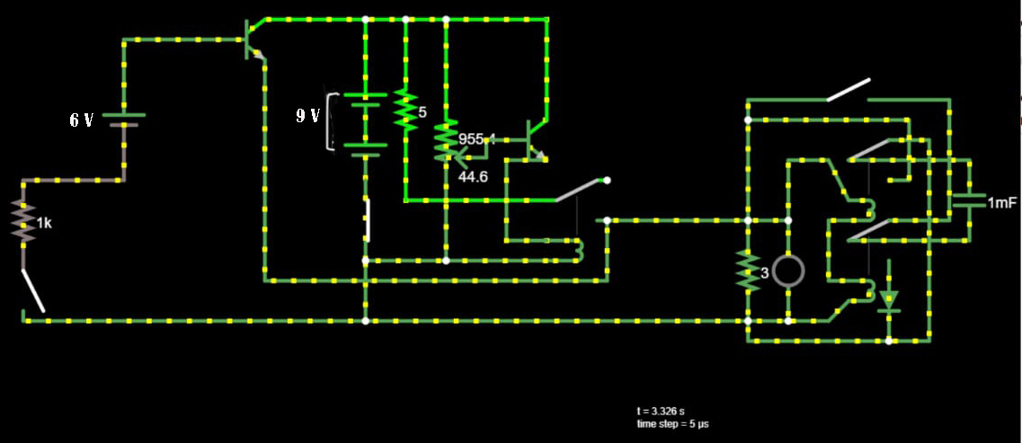
A LED bulb is attached in parallel combination which helps us to detect that the gas connection has been switched off.
The circuit is completed by attaching the wires to the corresponding terminals.
Notes:
Working, sketch, design, parts etc

Slide 9
UNIQUE SELLING POINTS
The KitchSafe 1101 utilizes simple electrical components and does the job perfectly.
The maximum temperature can be adjusted according to the food material cooked and spillage can be avoided by just setting up the maximum height upto which the contents can rise.
There are almost no moving components hence they are durable and easy to maintain.
This device doesn’t occupy much space and can be used pretty much for anything being cooked.
Considering everything, the retail price of the device is not expected to rise beyond 1500 INR.

Slide 10
Finishing Canvas
Working Instructions:
Place the electrode setup at the height of the vessel and make sure they are firmly set. Now, just set the maximum temperature till which the food is permitted to cook and done! Now you can relax without worrying as KitchSafe 1101 will take care next.
Limitations:
Current is constantly drawn as long as the mechanism keeps the gas outlet shut.
Relatively difficult to get 6V battery.
If not cleaned at regular intervals, the electrodes may get coated with dried food material over time which acts as an insulating coating and may thus prevent the devise from functioning.
The electrodes require to be mounted at a surface near the vessel using screws.
User Complexity:
Very user friendly- just mount the electrodes near the vessel, adjust their height conveniently depending on vessel.
Then just bring the tiny transistor mounted on a hinge joint with torsion spring in contact with the vessel.
Adjust the maximum temperature by adjusting the potentiometer. Switch on the device and we are ready to cook!
Designed with safety as one of the first priorities. Even after the vessel cools, the alnico solenoid retains magnetic field due to its coercivity and prevents gas flow until user manually presses the discharge switch.
Key Resources/Materials:
2 x NPN transistors
1 x Relay
1 x resistive wire as potentiometer
1 x 9V source, 1 x 6V source
2m long thin insulated copper wires for windings
1 x LED
Epoxy adhesive
Cost Structure:
NPN transistors 2*₹15 ₹30
12 V relay 3* ₹30 ₹90
6 V battery + case ₹260
9 V battery ₹35
2 m insulated copper wire ₹40
Potentiometer + LED ₹200
1mF capacitor ₹10

Slide 11
Thank you

